Slide 1
NUTRITION ai agent
CAPSTONE PROJECT
Presented By:Varshitha Nethi
Student name :Varshitha Nethi
College Name & Department :G. Narayanamma Institute Of Technology and Science | Computer Science & Engineering

Slide 2
OUTLINE
Problem Statement
Technology used
Wow factor
End users
Result
Conclusion
Git-hub Link
Future scope
IBM Certifications

Slide 3
Problem Statement
In the current landscape, generic diet apps and time-constrained nutritionists leave a critical void. Millions of people are searching for a true "health companion" that understands their unique body, lifestyle, and goals, not just a static database. The growing problem is the disconnect between the desire for personalized wellness and the inability of existing solutions to provide it with intelligence and empathy.
Proposed Solution: Our project addresses this with a groundbreaking Generative AI approach. Instead of a rigid app, we're building an adaptive AI agent that acts as a personal nutritionist. It not only generates tailored meal plans but also learns from your feedback, explains its choices, and understands your health story through natural language, input text . We’re not just providing information; we're creating a dynamic partnership for better health.

Slide 4
Technology used
IBM cloud lite services
Natural Language Processing (NLP)
IBM Granite model
Cloudant DB for user/feedback storage
Watsonx Agent Lab for building interactive agent logic
IBM Watson Studio with Python backend notebooks

Slide 5
IBM cloud services used
IBM Watsonx.ai Studio→ For writing and running notebooks and AI prompts.
IBM Watsonx.ai Runtime→ Powers and executes Python tools and AI logic.
IBM Watsonx Agent Lab→ To build the smart Nutrition AI Agent that uses tools + LLM.
IBM Granite Foundation Model→ The brain behind meal plan generation and explanations.
IBM Cloudant NoSQL DB→ To store user feedback and meal data securely.
IBM Cloud Object Storage→ To upload food guidelines and use them in the AI knowledge base.

Slide 6
Wow factors
This AI Nutrition Agent transforms generic diet tools into truly personalized wellness companions—generating expert meal plans in seconds, adapting to real-time feedback, and empowering users across cultures, lifestyles, and health conditions.This AI combines the reasoning of a doctor, the planning of a dietician, and the speed of generative AI—offering 24/7 support that adapts with user feedback.
Unique features:
Highly personalized meal plans
Real-time feedback adaptation
Cultural and medical condition awareness
Semantic food swap suggestions
Doctor + Dietician + AI = Super Nutrition Assistant
Modular and expandable design

Slide 7
End users
Individuals with specific dietary needs (e.g., PCOS, Diabetes)
Fitness enthusiasts and athletes
Nutritionists and dieticians
Health-tech startups
Hospitals and wellness centers

Slide 8
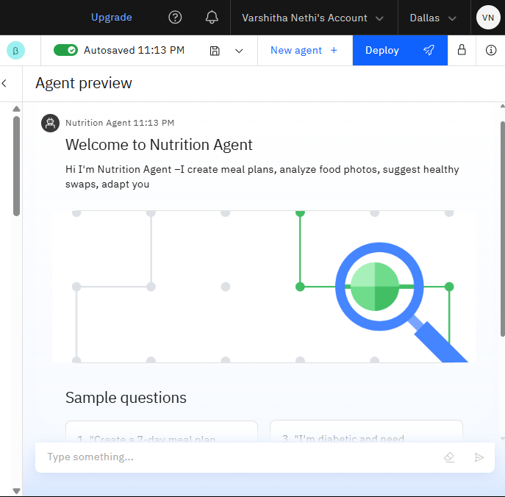
Results

Slide 9
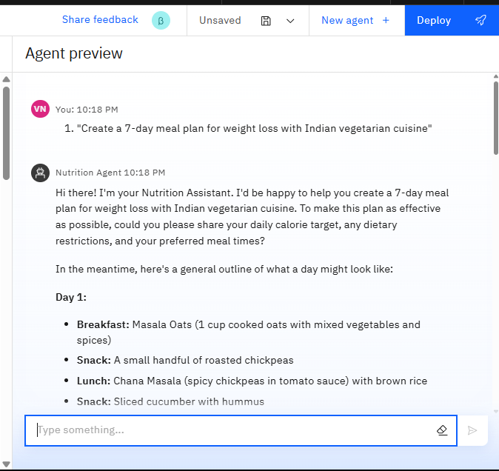
Results

Slide 10
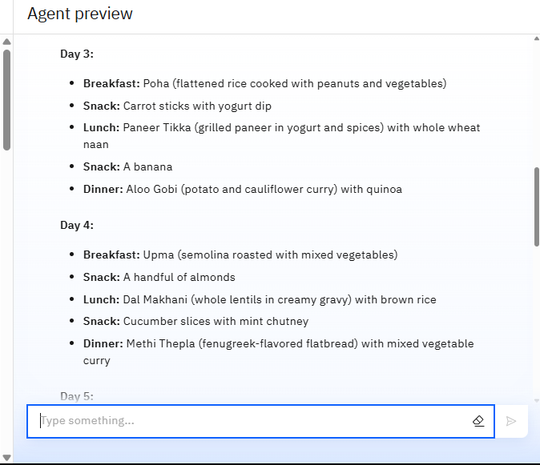
Results

Slide 11
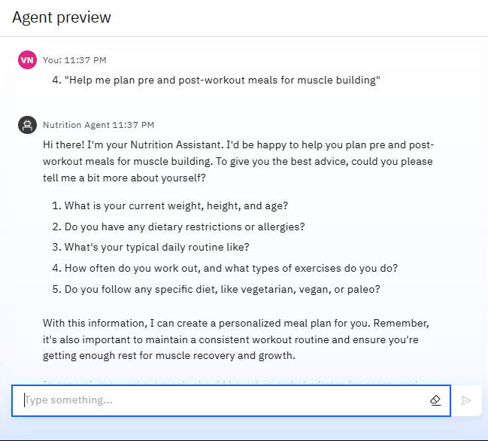
Results

Slide 12
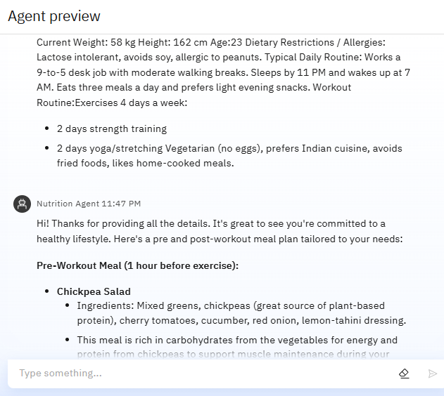
Results

Slide 13
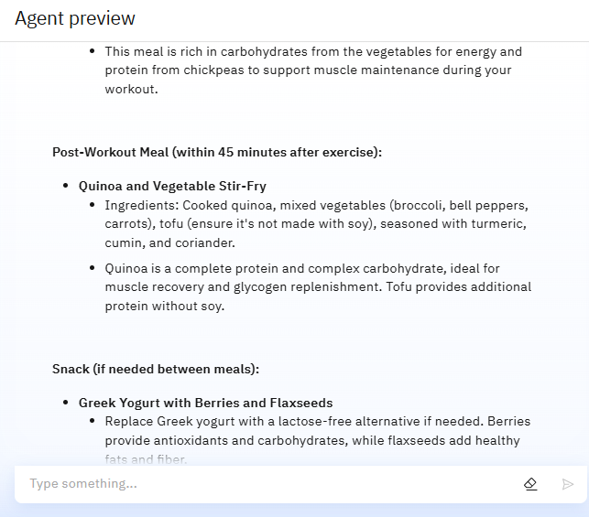
Results

Slide 14
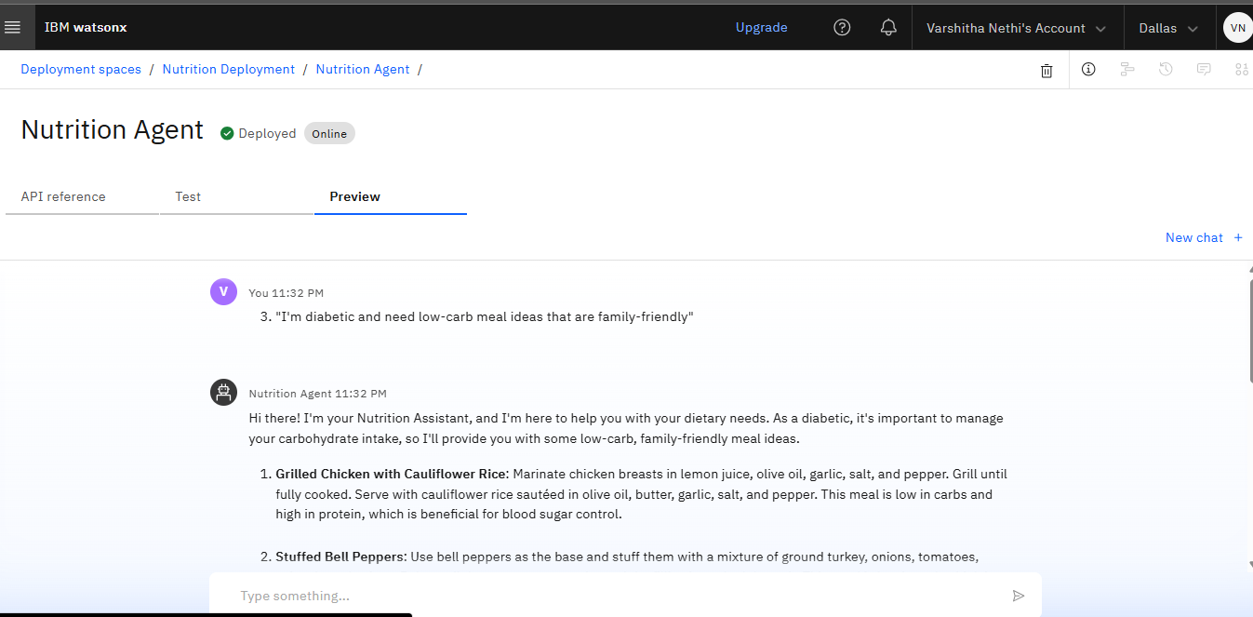
Results
Deployed AI Agent

Slide 15
Conclusion
Our AI-powered Nutrition Agent, built fully on IBM Cloud & Watsonx, redefines wellness by delivering empathetic, adaptive, and explainable guidance—just like a real nutritionist would.
It saves time for both users and professionals by automating personalized guidance.
It enhances health outcomes and accessibility to nutrition expertise.
Understands the user’s goals, learns from feedback, explains its reasoning and evolves with every interaction

Slide 16
Future scope
Multilingual Support
Integration with voice/image input
Scan grocery labels to detect unhealthy foods
Connect to fitness wearables
API for dieticians to plug-in
Mobile app frontend with IBM Code Engine

Slide 17
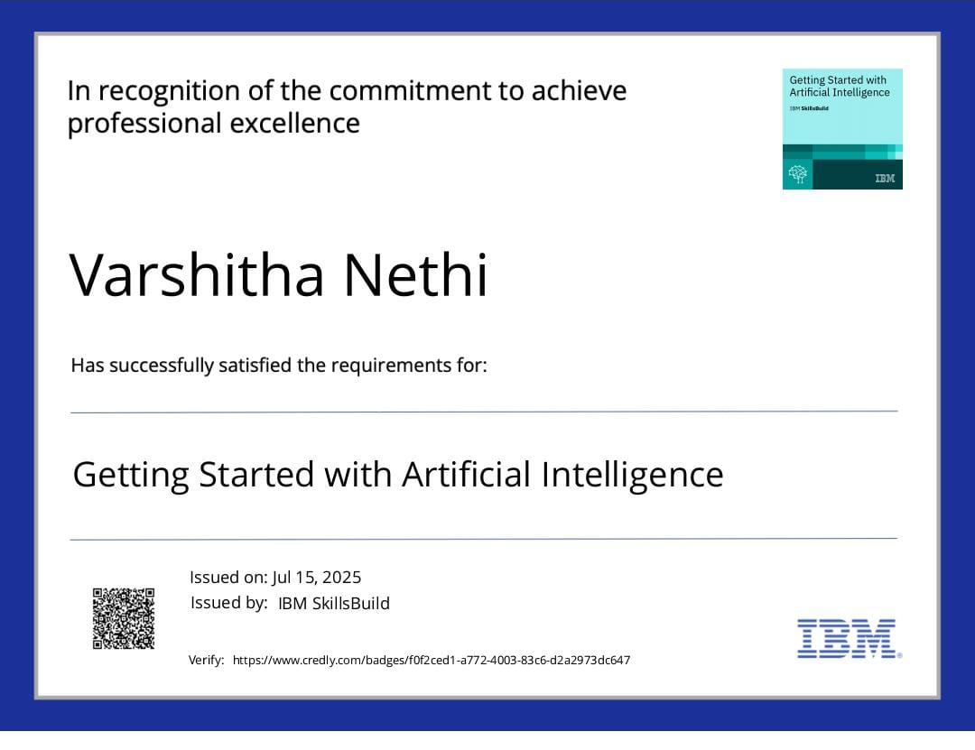
IBM Certifications

Slide 18
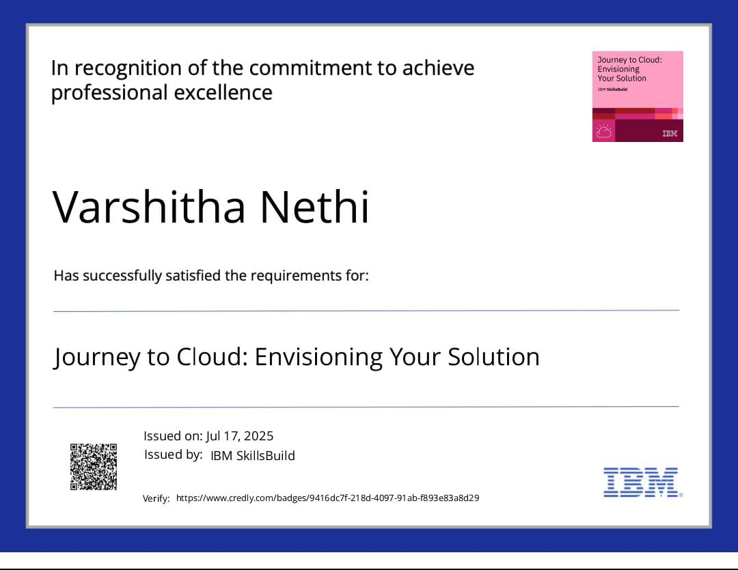
IBM Certifications

Slide 19
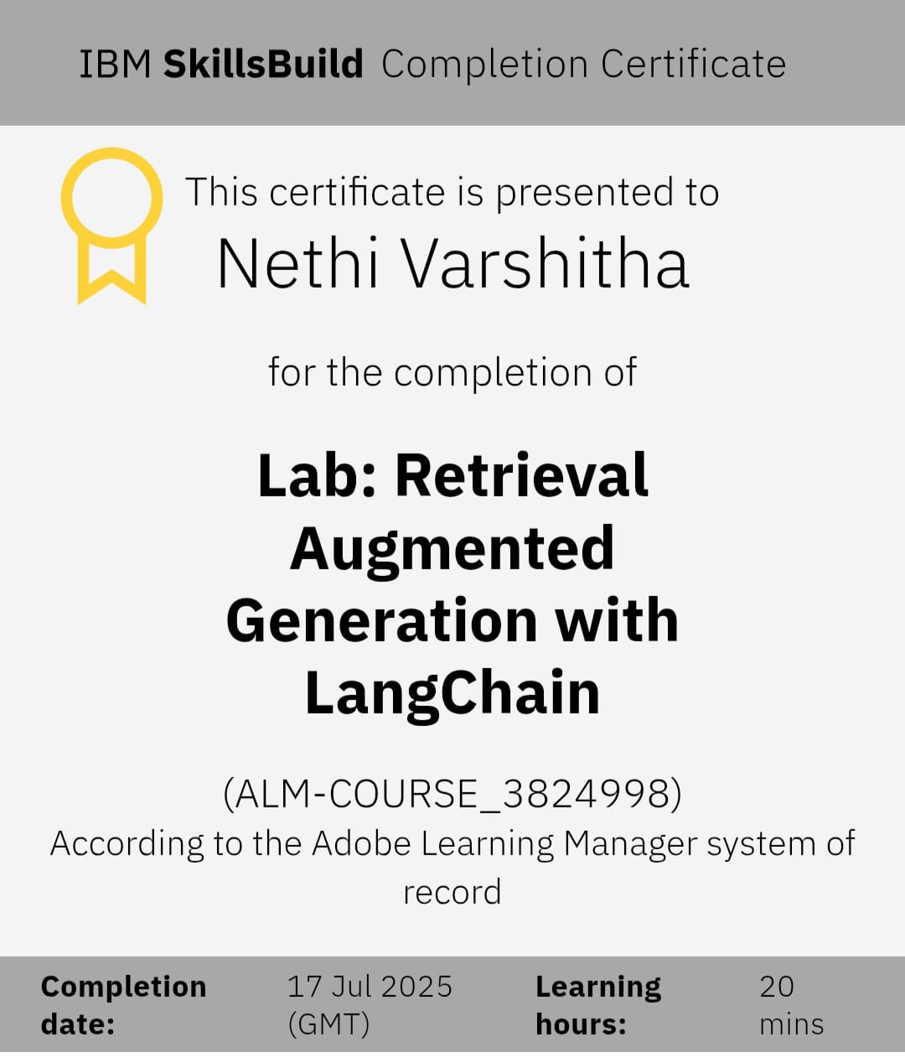

Slide 20
GitHub Link-readme
https://github.com/varshithanethi/Nutirtion-Agent-/blob/main/README.md

Slide 21
GitHub Link
Git hub link : https://github.com/varshithanethi/Nutirtion-Agent-

Slide 22
THANK YOU

